Slide 1
BEN ANDERSON Colliers | Wisconsin
Notes:
Thanks Pam. 2020 certainly was an interesting year for the office market.

Slide 2
Market Overview
Submarket | Number Of Buildings | Inventory | Total Available | Available % | Total Vacant | Vacant %
North | 69 | 4,100,413 | 1,596,848 | 38.9% | 1,274,548 | 31.1%
West | 148 | 7,627,799 | 2,004,483 | 26.3% | 1,267,050 | 16.6%
Central | 161 | 21,165,682 | 4,128,143 | 19.5% | 3,098,150 | 14.6%
South | 29 | 1,610,146 | 136,195 | 8.5% | 119,085 | 7.4%
TOTAL | 407 | 34,504,040 | 7,865,669 | 22.8% | 5,758,833 | 16.7%
Compared to 2019 | +8 | +1,349,470 | +1,589,621 | +3.9% | +1,331,170 | +3.3%
Notes:
To give a lay of the land, the

Slide 3
How has the pandemic impacted the market?

Slide 4
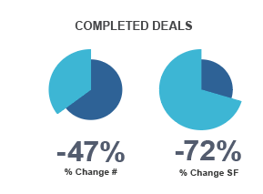
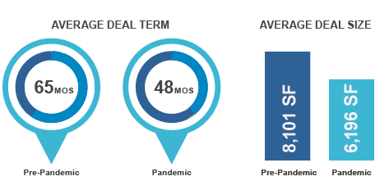
2020 Deal Dynamics

Slide 5
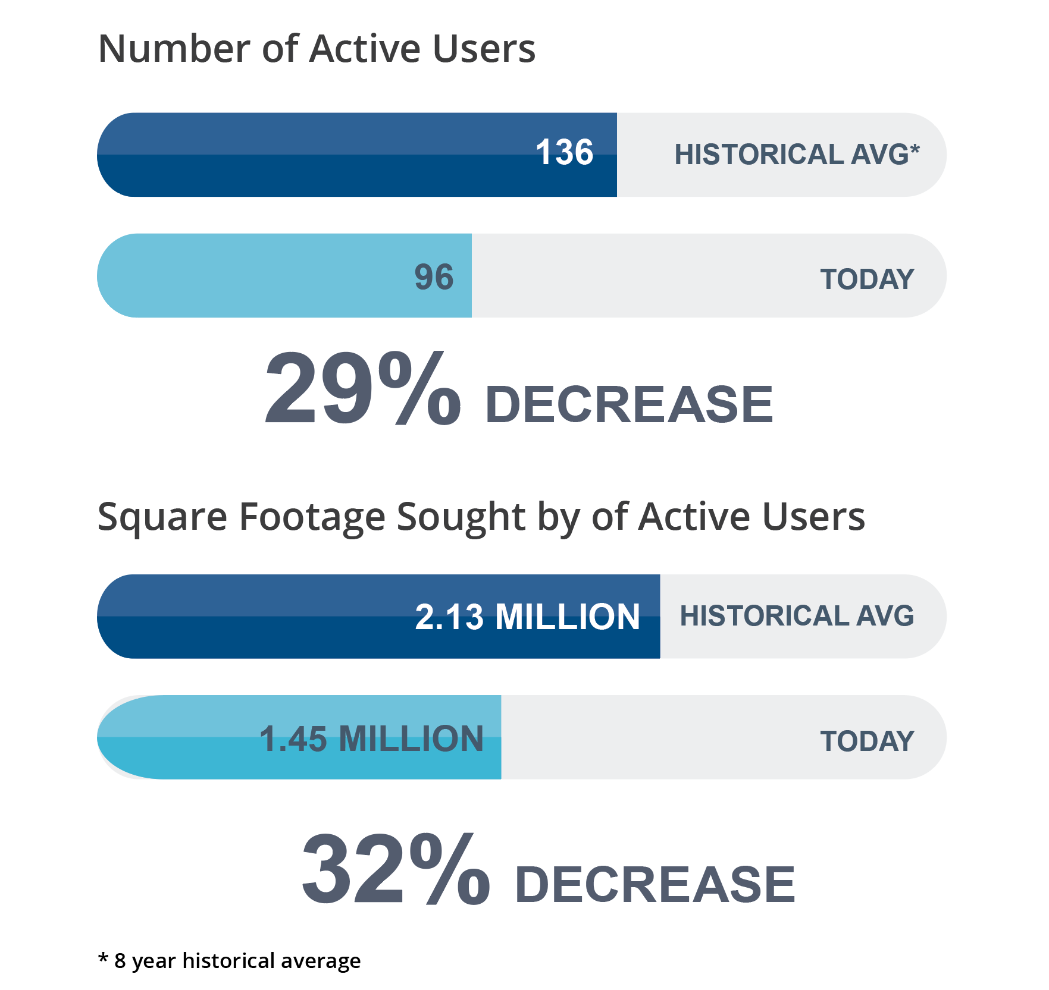
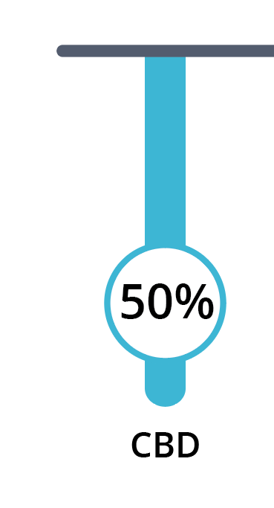
2020 Demand Dynamics
50% Drop in Demand
Since January 2020

Slide 6
2020 Notable Deals
SIGNED PRE-PANDEMIC
Milliman
Hydrite
North Shore Healthcare
Legal Action of Wisconsin
Ross Innovative Solutions
Advent Health
Bradley Foundation
Johnson Bank
Mindful Staffing
Kahley Slater
1400 N Water St Milwaukee, WI 15,700 SF
633 W Wisconsin Ave Milwaukee, WI 23,200 SF
640 N 4th St
Milwaukee, WI 22,683 SF
The Corridor
Brookfield, WI 45,000 SF
The Corridor
Brookfield, WI 118,300 SF
7800 W Brown Deer Rd
Milwaukee, WI 40,282 SF
10001 W Innovation Dr
Wauwatosa, WI 28,351 SF

Slide 7
2020 Notable Deals
SIGNED DURING THE PANDEMIC
790 N Water St
Milwaukee, WI 14,745 SF
555 E Wells St
Milwaukee, WI 40,500 SF
11700 W Lake Park Dr
Milwaukee, WI 32,300 SF

Slide 8
Office Market Disruptors

Slide 9
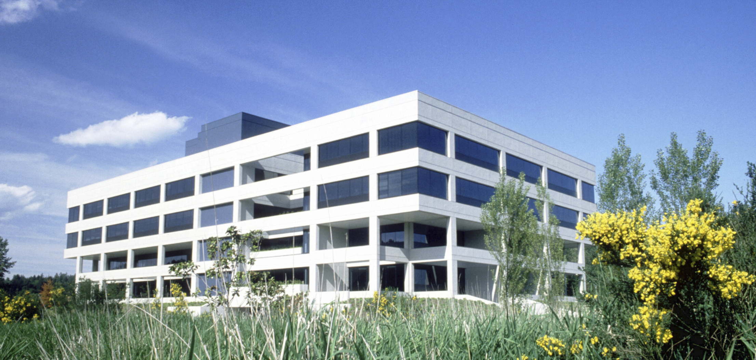
Suburban Office
Pre 2000’s

Slide 10
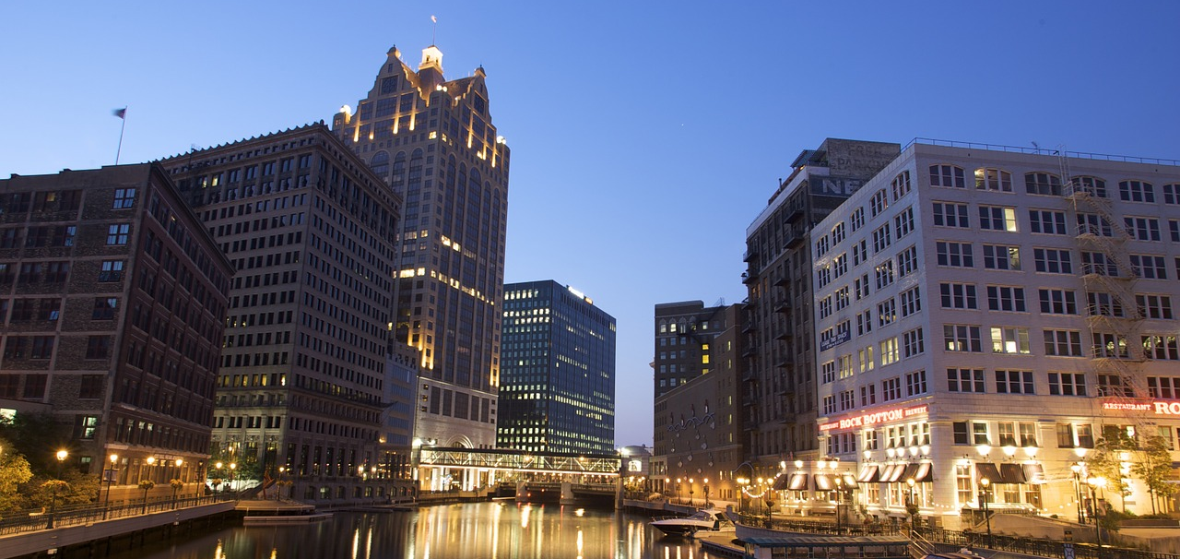
Strength of Downtown
2000 - 2020

Slide 11
Work From Anywhere
2020 - TBD

Slide 12
Decision Making Process
PRE-PANDEMIC
What is our culture?
What area / location can we best attract talent?
What space/property best accomplishes our goals while hitting our target economics?

Slide 13
Decision Making Process
PANDEMIC
What is our culture?
How do we operate as an organization? (Collaboratively vs Independently)
How can we ensure employee safety in the workplace?
(Ventilation, Touch Points, etc.)
What tactic best accomplishes these objectives?
(Office Environment, Home Environment, Combination?)

Slide 14
It is a Tenants Market

Slide 15
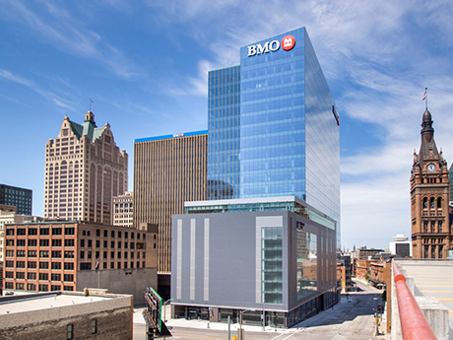
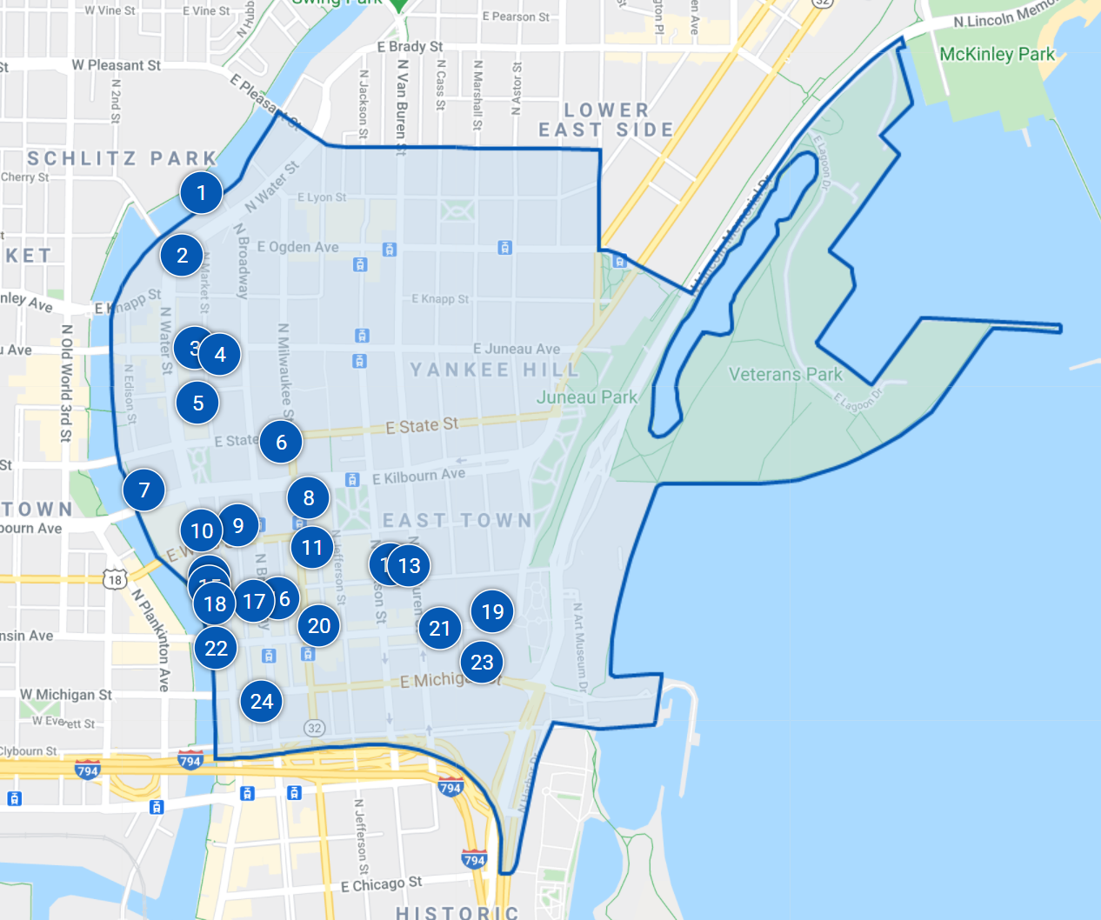
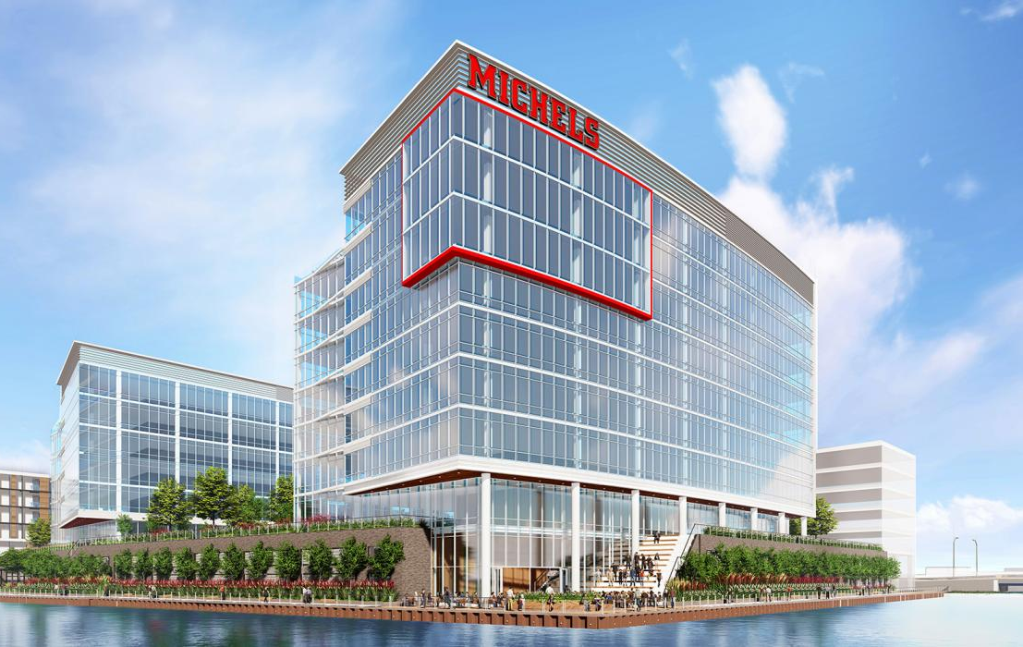
Tenants Have Choices
Delivery of BMO Tower
Availability in US Bank
R1VER

Slide 16
What is the Value Proposition?

Slide 17
Landlord Value Proposition

Slide 18
How did Jim do?
2020 Predictions - Jim Cavanaugh, Cushman & Wakefield | Boerke
Fiserv will locate downtown
A major corporate tenant will announce a substantial suburban development
The DNC will be a “Brokered” Convention

Slide 19
2021 Predictions
Office isn’t dead! There will continue to be increased interest in the suburbs, lower rise buildings, and single tenant sites.
A vaccine will become readily available by summer 2021 leading the majority of companies to return to the office at full capacity.
Demand for office space will increase significantly in Q3 & Q4
Giannis will lead the Bucks to the NBA finals.

